Slide 1
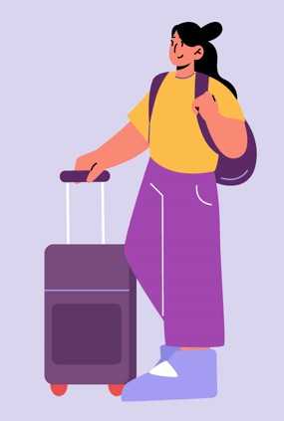
Journey:
Making travelling easier

Slide 2


Introduction
Explore the city to progress.
Learn local phrases and history.
Customize your journey to your liking.

Slide 3

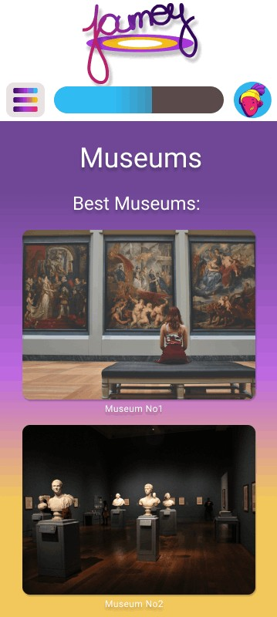
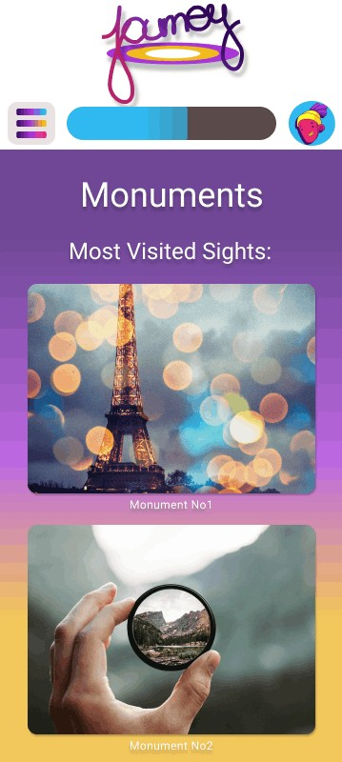

E plore the city
Visit the recommended locations to
progress.

Slide 4

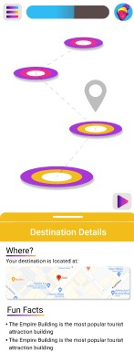
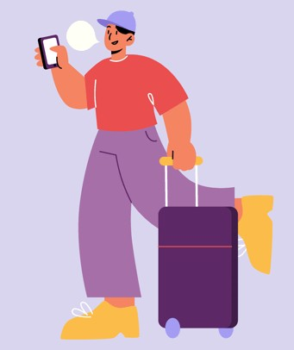
Learn local phrases and
history
When you arrive at a destination, learn useful phrases like ordering food and asking for direction, as well as the
history of the locations

Slide 5

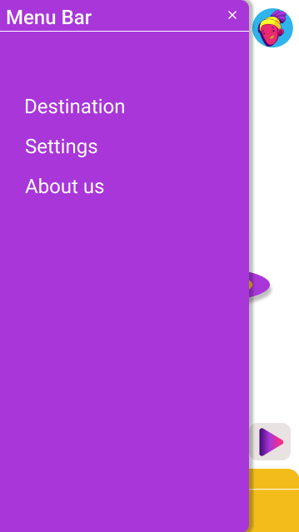
Customize your
journey
Choose how you want to explore the city.

Slide 6

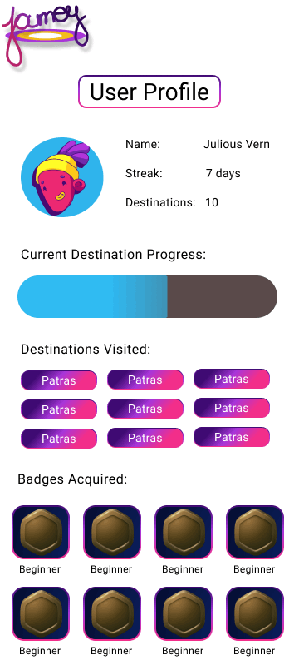
Track your progress
As you explore various cities, your progress is shown by the progress bar
and personalized badges.

Slide 7


Join our

